Slide 1
When Charts Get Dangerous
Training for the Foundations of Data Viz

Slide 2

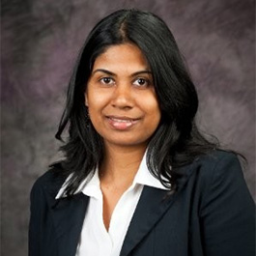





Today’s panel
Daniela
Thilani
Cameron
Jasmine

Slide 3
A bit about the panelists
3. Your favourite holiday?
□ New Years’
□ Halloween
□ My birthday

Slide 4
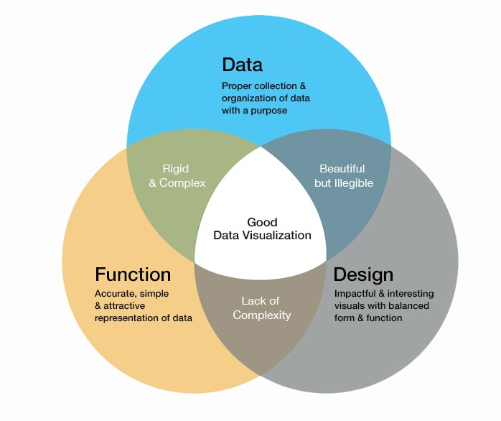
What makes a good visualization?
https://www.nabler.com/articles/the-data-visualization-manual-that-you-will-want-to-bookmark/

Slide 5
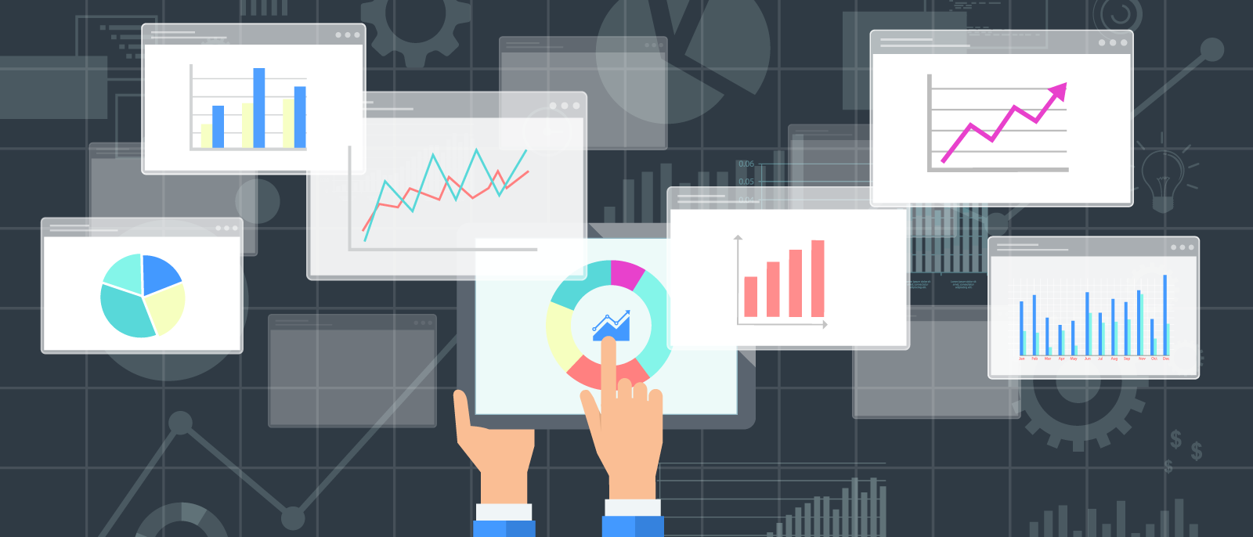
https://golagoon.com/how-do-i-make-a-google-spreadsheet/how-to-make-a-column-or-row-visible-always-in-google-spreadsheets-do-i-spreadsheet-fit-on-o/

Slide 6
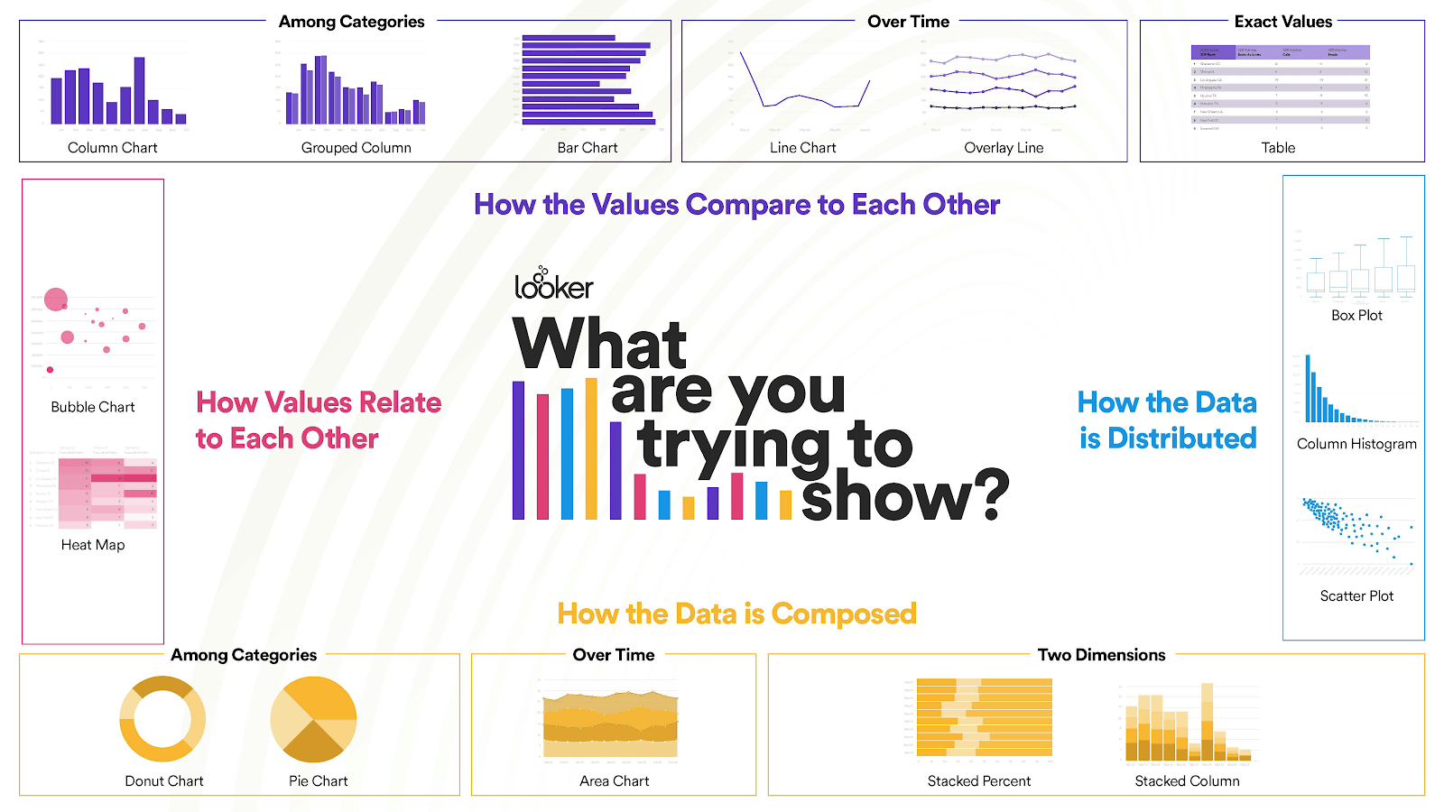
https://looker.com/blog/different-types-graphs-charts-uses

Slide 7
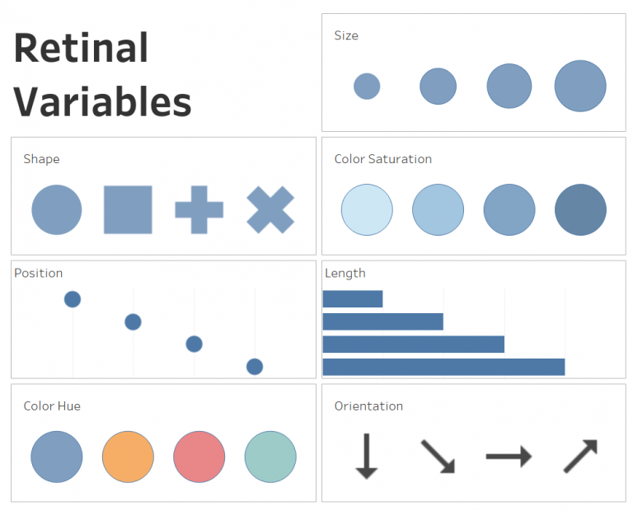
Visual encoding
Visual encoding is converting a visual image to understand it as an object.
Encoding of retinal variables to become visually informative.
What are we able to decode most accurately?
Position, length, and size
https://vizpilgrim.com/2019/11/01/visual-encoding/

Slide 8
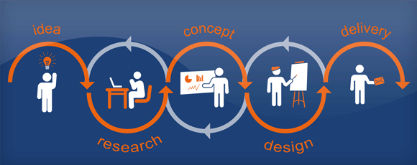
Graphic design
Creating visual communications to convey a message effectively
Use of design tools like Adobe Illustrator.
Best practices, design theme, creativity, accuracy, and accessibility
https://www.howdodesign.com/the-graphic-design-process-getting-ready/, https://help.tableau.com/current/pro/desktop/en-us/accessibility_best_practice.htm

Slide 9
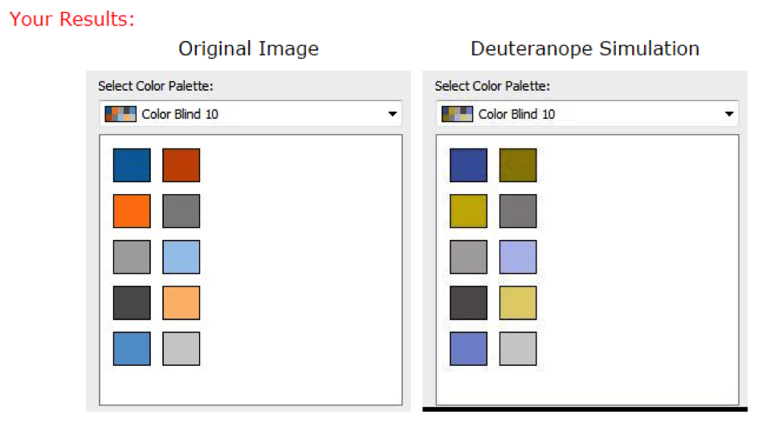
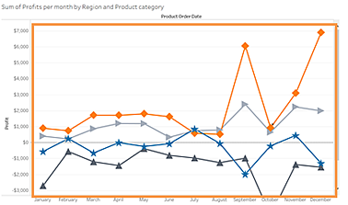
Accessibility
Keep it simple.
Use color-blind palettes to create visualization.
Use a color Blindness Simulator
For line marks, use additional options like shapes, size, and labels.
Image infographics require an alternative text description in the form of a transcript.
E.g.: Transcript can be displayed below an image infographic.
https://help.tableau.com/current/pro/desktop/en-us/accessibility_best_practice.htm, https://www.csun.edu/universal-design-center/accessible-infographics, https://www.tableau.com/about/blog/2016/4/examining-data-viz-rules-dont-use-red-green-together-53463, https://www.color-blindness.com/coblis-color-blindness-simulator/

Slide 10
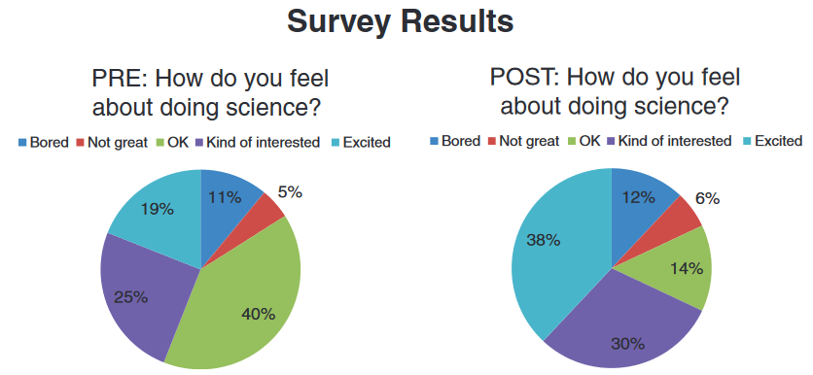
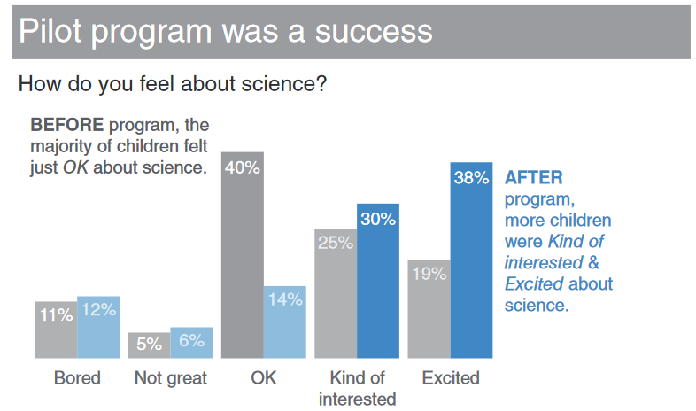
Before
Difficult to gain insights
Reasons: pie charts, color, legends
After
A successful visualization!!
Reasons: bar chart, color, clear text
Knaflic, Cole Nussbaumer. Storytelling with Data : A Data Visualization Guide for Business Professionals. Hoboken, New Jersey: Wiley, 2015. Web.

Slide 11
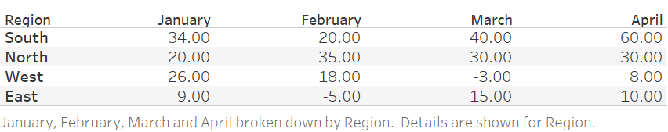
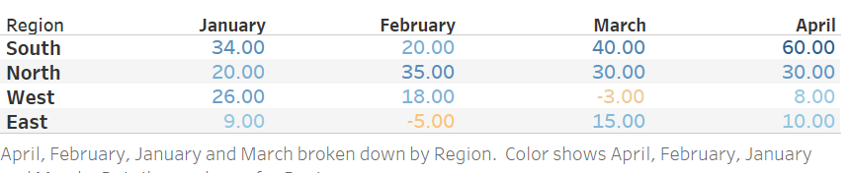
Use highlighting and colors
Profit % for regions from January - April

Slide 12
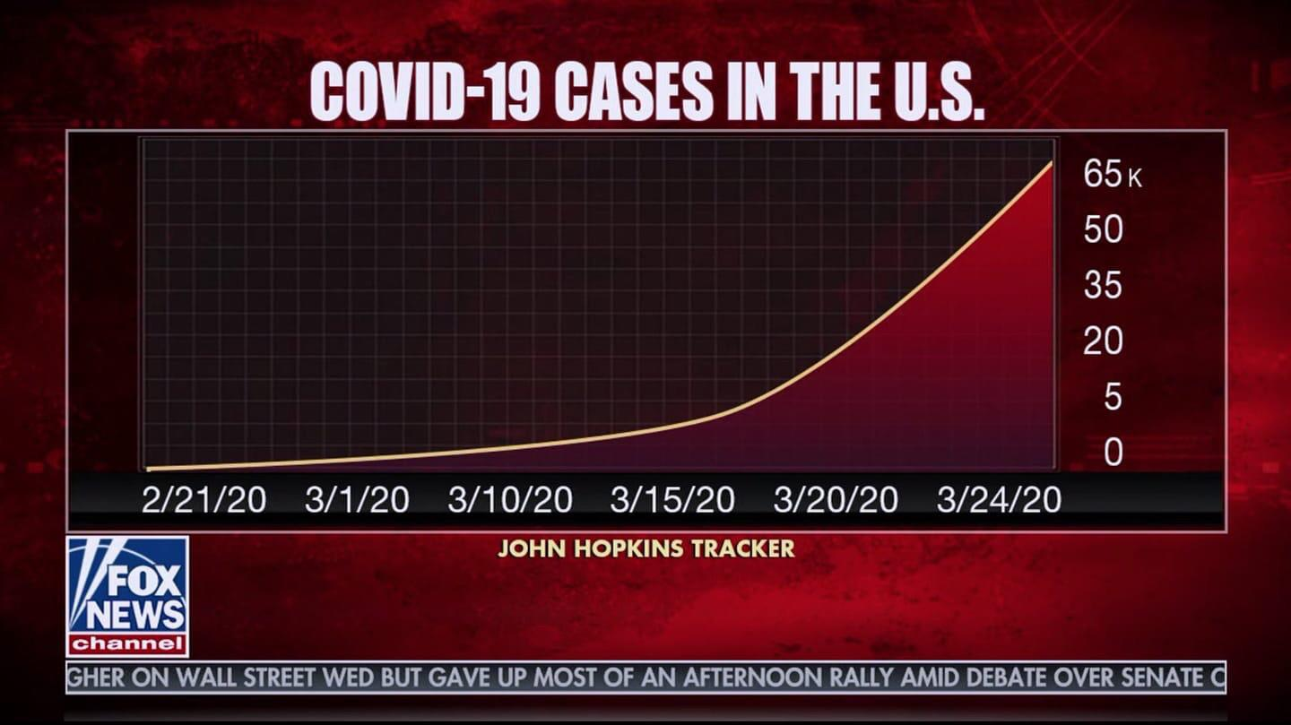
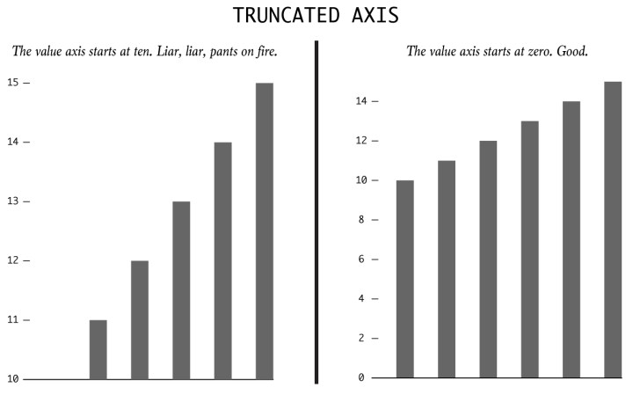
What leads to misleading visualizations?
Manipulating the Y-axis
Truncated axes - omitting the baseline
https://venngage.com/blog/misleading-graphs/, https://flowingdata.com/2017/02/09/how-to-spot-visualization-lies/

Slide 13
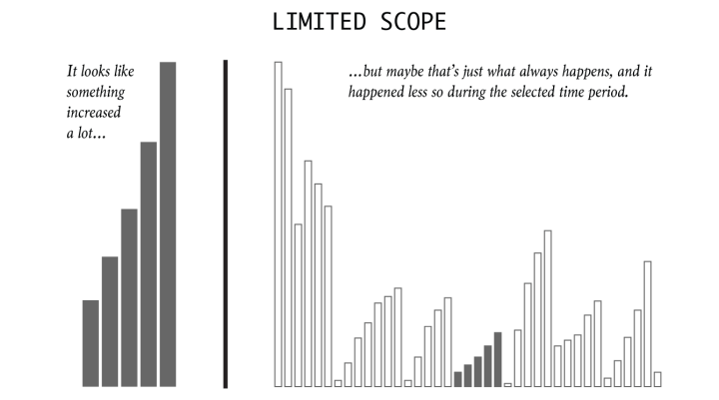
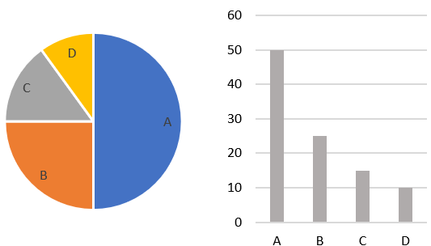
What leads to misleading visualizations?
Omitting data - trends can be misleading
Choosing the wrong graph
https://flowingdata.com/2017/02/09/how-to-spot-visualization-lies/, https://www.boldbi.com/blog/your-pie-chart-questions-answered-here

Slide 14
Key topics in data visualization
Cameron Riopelle, PhD
Head of Data Services
University of Miami Libraries

Slide 15
Ethos
Graphical excellence is:
Nearly always multivariate.
That which gives to the viewer the greatest number of ideas in the shortest time with the least ink in the smallest space.
The well-designed presentation of interesting data-a matter of substance, of statistics, and of design
(Edward Tufte, The Visual Display of Quantitative Information, 51)
To make good visualizations, you need to understand not just your audience but the structure of your data.

Slide 16
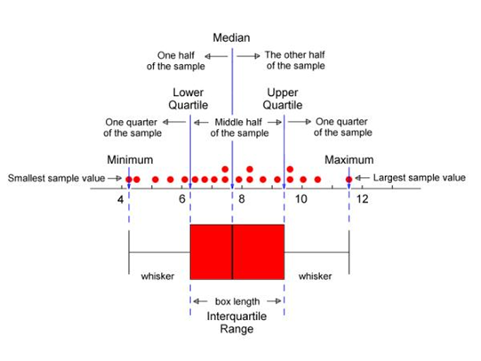
Know Your Data
What is the file format?
Is your data clean?
What is the appropriate measure of central tendency?
Measure of dispersion?
Is your data skewed?
What is the level of measurement - nominal, ordinal, interval/ratio?
Do you need to aggregate before visualizing? If you aggregate, do you lose complexity or over-simplify?
Image from http://web.pdx.edu/~stipakb/download/PA551/boxplot.html

Slide 17
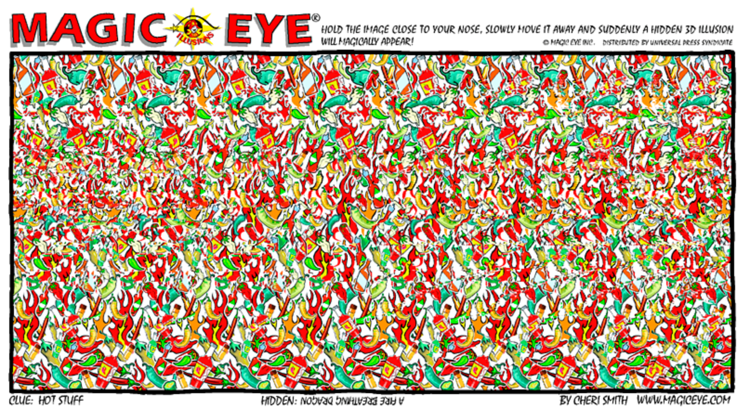
Exploratory vs. Confirmatory Data Analysis
Exploratory: Looking for patterns and trends
"The greatest value of a picture is when it forces us to notice what we never expected to see" (Tukey, Exploratory Data Analysis)
Patterns can be misleading. We identify patterns when there aren’t any.
Confirmatory: Hypothesis Testing

Slide 18
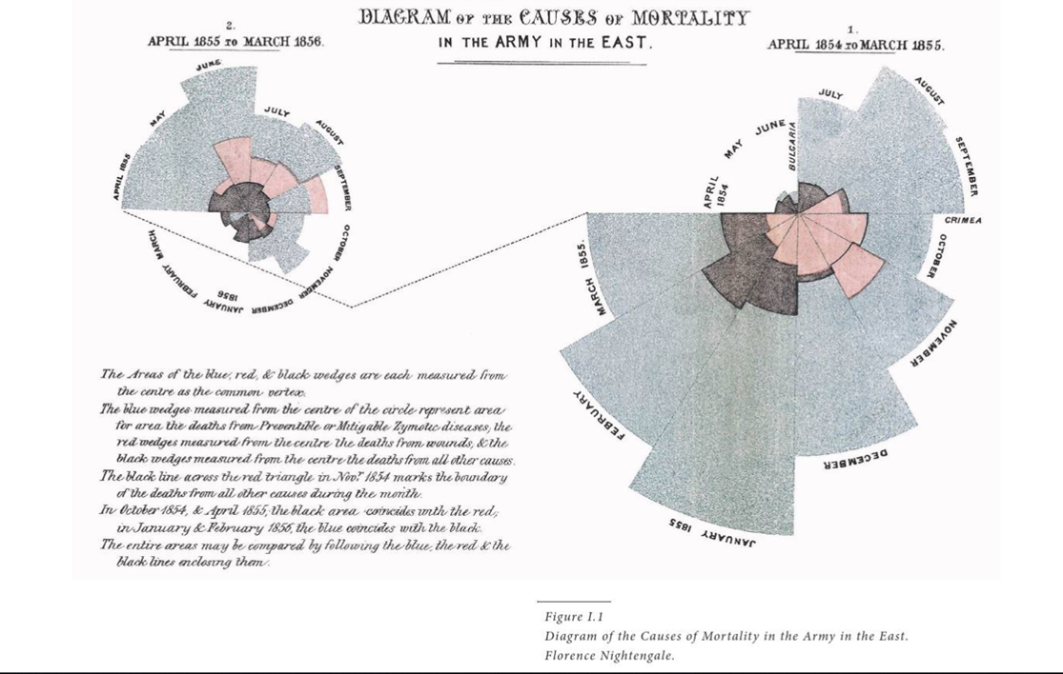
Lankow, Crooks, and Ritchie (2014): 15

Slide 19


Slide 20
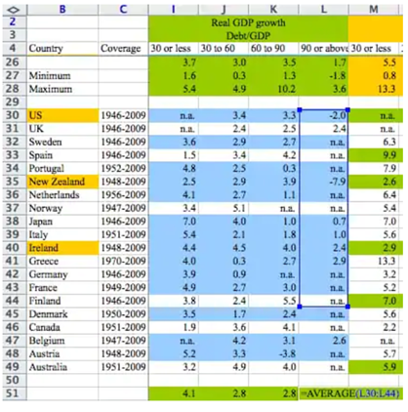
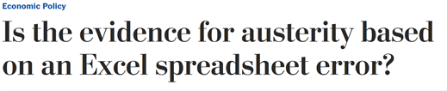
When should you use scripts?
https://www.washingtonpost.com/news/wonk/wp/2013/04/16/is-the-best-evidence-for-austerity-based-on-an-excel-spreadsheet-error/

Slide 21
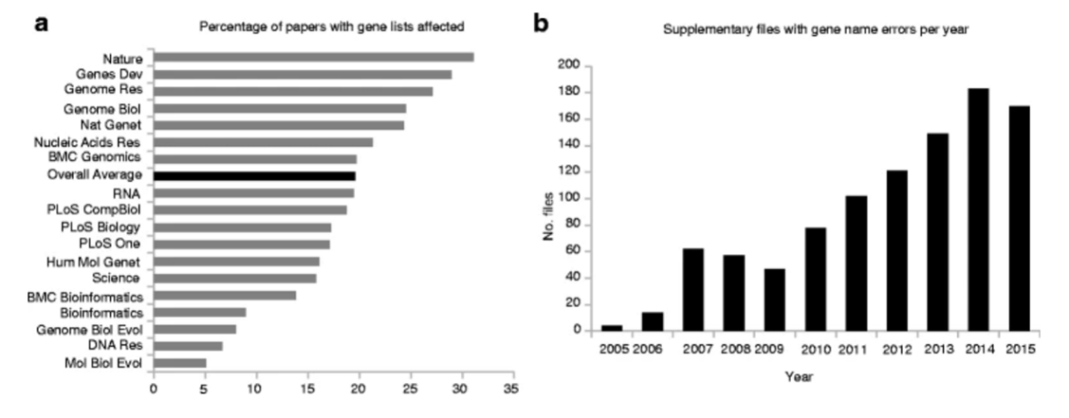
Nearly 20% of scientific papers that used Excel for genomic data analysis contain errors related to Excel’s automatic date format conversion (Ziemann, Eren, and El-Osta, 2016)
Article and images from https://genomebiology.biomedcentral.com/articles/10.1186/s13059-016-1044-7

Slide 22
Takeaways
Small ideas:
Visualizations should appeal to different types of learners
Labels are helpful
Colorblindedness
Color can be used to accentuate key points
Standardize units and axes when possible
Big ideas:
Don’t lose track of your key message
Pilot your visualization
“Graphical excellence requires telling the truth about the data.” (Tufte, 51)

Slide 23
Bringing Data Visualization Instruction to Your Library
Jasmine Kirby

Slide 24
Outline
Data literacy as part of information literacy
Interdisciplinarity
Providing training
Managing expectations

Slide 25
Data literacy as part of information literacy

Slide 26
Spotlight on the framework
Can teach all of the ACRL framework but especially:
Information Creation as a Process
"Framework for Information Literacy for Higher Education", American Library Association, February 9, 2015.
http://www.ala.org/acrl/standards/ilframework (Accessed February 3, 2021)
Document ID: b910a6c4-6c8a-0d44-7dbc-a5dcbd509e3f

Slide 27
Building good habits and expectations for data visualization early on
Letting people know they have data to visualize
Teaching people how to find and cite datasets and how to critically evaluate these sources
Notes:
Maps!

Slide 28
Story time: What to do when finding the perfect dataset seems inconceivable…
One shot data literacy program for upperclassmen in a statistics course, originally an in person session now a LibWizard tutorial
Based on finding data on the countries and rodents of unusual size from the movie The Princess Bride
Encourages students to take a more critical view of data and data visualizations they will encounter while researching

Slide 29
Interdisciplinarity

Slide 30
Library as a truly interdisciplinary space
Many of us find ourselves liaising for a bunch of unrelated subjects
We know about and study different research methodologies

Slide 31
Tools
We familiarize ourselves with the latest software tools to support our departments and in our own research
People don’t always use the right tool for what they are trying to do
Getting people to ask if what they are doing requires that tool is important
Notes:
For example I’m part of #TeamZotero but really I care about that someone has put some thought into how they manage their citations even if they concluded I’m just going to put them in a Word Doc
Best way to move past looking at some of the things people do with software from screaming to acceptance

Slide 32
Yes you can provide training
Even when you are also learning

Slide 33
Higher education: the learning never stops
A lot of what we offer is lifelong learning and training and professional development, self-directed learning
So many free open resources available online

Slide 34
Getting people to try new things, together
Hosting workshops that bring together people from a variety of disciplines and backgrounds
Advertising software tools and learning resources available through the library that people may not have known about
Notes:
Figure out what people are doing and what they think the library should be doing
Figure out what the needs are on campus
Etc.

Slide 35
Story time: Slytherin House Initiative at Iowa State University
A book club about learning Python open to the entire library that took over a computer lab on Friday afternoons
Also brought Software Carpentry to campus for the library
Resulted in a couple of projects based on using Python to solve various library issues
Notes:
Recognized a need because it was very hard for librarians as adults / non majors to register for traditional computer science courses available at the school

Slide 36
Managing Expectations

Slide 37
Improving awareness of how practical stuff is by having people try to do it
Main goal of Slytherin house was to show people what was possible with using Python and bring people from different parts of the library together to cross pollinate knowledge
Skunkworks and making space for people to figure out what is a good or a bad idea before getting too invested
Morgan, P. (2020, January 14). Reconsidering Skunkworks. Paige Morgan Blog. http://blog.paigemorgan.net/articles/20/reconsidering-skunkworks.html
Nowviskie, B. (2013). Skunks in the Library: A Path to Production for Scholarly R&D. Journal of Library Administration, 53(1), 53–66. https://doi.org/10.1080/01930826.2013.756698

Slide 38
Story time: ArcGIS Story Maps workshop
Part of a GIS day celebration in collaboration with campus and local GIS user groups
Chosen because it is a very easy to use tool with excellent documentation
Help people learn how much GIS they can realistically learn in a one hour library workshop
Had to switch to Esri ArcGIS Story Maps because Knight Lab’s StoryMap JS did not offer any accessibility features or workarounds at the time. You have the power.
Notes:
that included a maps book display in collaboration with the GIS department on campus and Iowa Geographic Information Council
ArcGis
The tools you like other people will also probably like for the same reasons lol
Someone really thought I was going to teach ArcGIS in an hour for free
People don’t know what they don’t know
Faculty expectations for technology are like faculty expectations for copyright law

Slide 39
Don’t let data visualization out of the purview of library instruction!

